Slide 1
Elliptic Curve Cryptography
Hoang Nguyen
CS 131

Slide 2
Introduction to Elliptic Curve Cryptography
The elliptic curve algorithm was first described in 1985 by Victor Miller and Neal Koblitz. Elliptic curve cryptography (ECC) is based on the fact that finding the discrete logarithm of a random elliptic curve element with respect to a publicly known base point is difficult to the point of being impractical.
There are numbers of variations, such as ECC-DH (ECC Diffie-Hellman) and ECC-DSA (ECC Digital Signature Algorithm).

Slide 3
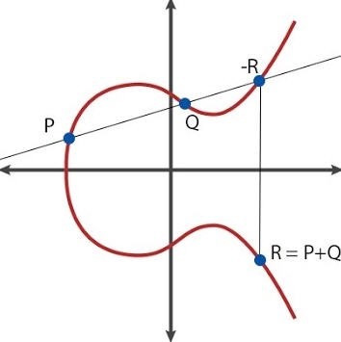
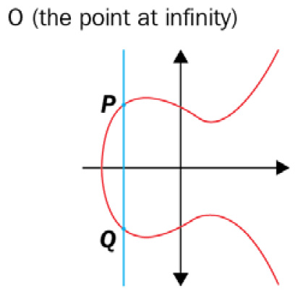
Background on Elliptic Curves
The first observation is that an elliptic curve is not an ellipse. The general mathematical form of an elliptic curve is as follows:
E: y² = x³ + ax² + bx + c
The SUM value of two points of the curve: P + Q is a point R on the curve. If we draw a line between P and Q, a third point, -R, is given by the intersection between this line and the curve. Then, if you take a reflex of point -R with respect to the x-axis line, you find R.
Here is O represented by the point of infinity, given by the SUM value between P and Q if xP = xQ

Slide 4
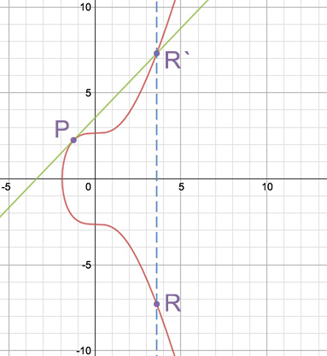
Elliptic Curve Cryptography Basics
What about computing P + P = R = 2P, the so-called point double? If we want to represent a P point added to itself so that it becomes 2P, the geometrical representation is given by the tangent passing through the P point and intersecting the curve at the R` point, and again finding the reflexed point of the sum that is the symmetric point R.
Scalar multiplication: This process mathematically represents the sum between P and Q and makes it possible to calculate 2P, 3P, …, nP on elliptic curves.
Q = n*P
Q = {P + P+ P + P…+ P} n-times

Slide 5
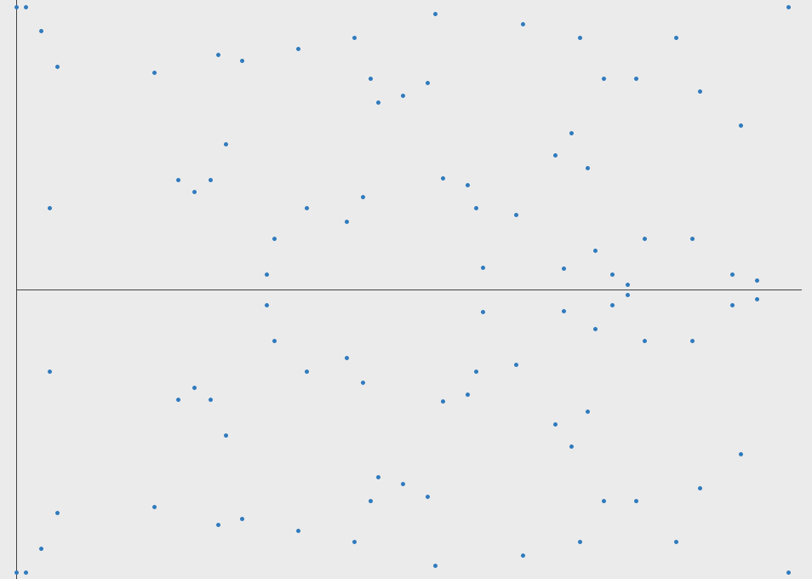
Example of an EC defined over integers modulo p (finite field)

Slide 6
Implementing the Diffie-Hellman algorithm on elliptic curves
The problem underlying the D–H key exchange is the discrete logarithm. The discrete logarithm problem could be transposed on elliptic curves too. Scarlar multiplication is a “One Way Function”
Given an Elliptic Curve defined over the field of integers modulo p. And 2 points Q, P on this curve such that Q is a multiple of P. It is impractical to find k such that Q=kP.

Slide 7
Implementing the Diffie-Hellman algorithm on elliptic curves (Continued).
The base point or generator point: G (a point on the curve that generates a cyclic group)
Cyclic group means that each point on the curve is generated by a repeated addition.
The order of G denoted by (n) is the size of the group. The order n is also the smallest positive integer k, giving us the following: kG = O (Infinity Point)
The h cofactor: h can be defined as the number of points on E (mod p) divided by the order of the curve n. h = 1 is optimal. If h > 4, the curve is more vulnerable to attacks.

Slide 8
Implementing the Diffie-Hellman algorithm on elliptic curves (Continued).
Step 1: Parameter initialization:
E (mod p): {p, a, b, G, n, h}
p is the (mod p)
a and b are the parameters of the curve
G is the generator
n is the order of G
Step 2: Crafting the shared key on E (mod p):[K]
After the parameter initialization, Alice and Bob will define the type of the curve to adopt among the family of
E (mod p): y² = x³ + ax + b (mod p)
Bob picks up a β private key such that 1≤ β ≤ n-1.Alice picks up a α private key such that 1≤ α ≤ n-1.
After choosing random keys, Bob and Alice can compute their public keys. Bob computes the following: B = β * G. Alice computes the following: A = α * G.
Bob sends B to Alice. Alice sends A to Bob.
Bob computes K = β * A = β * α * G
Alice computes K = α * B = α * β * G
This point, K is the shared key between Alice and Bob.

Slide 9
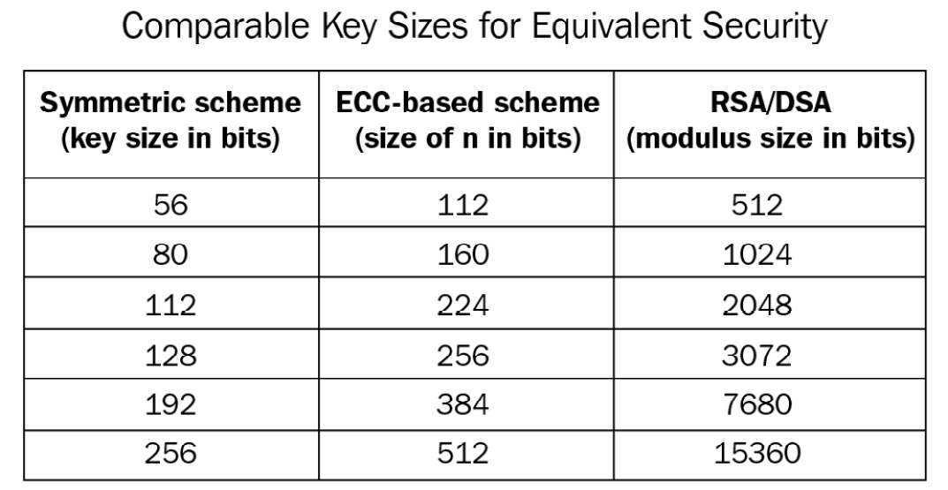
Security of ECC
Security advantages of ECC compared to other cryptographic systems:
ECC offers the same level of security as traditional cryptographic systems but with smaller key sizes, making it more efficient in terms of computational resources and bandwidth.
Current standards and implementations that use ECC:
ECC is widely used in modern cryptographic protocols and systems, including SSL/TLS, Bitcoin, and mobile devices.
As you can see, 256-bit encryption performed on ECC is equivalent to a 3,072-bit key on RSA

Slide 10
Challenges
Challenges or limitations of ECC:
Quantum computing: ECC_DH is vulnerable to attacks from quantum computers, which could compromise its security by efficiently solving the underlying mathematical problems.
Diffie-Hellman Attacks: ECC_DH shares vulnerabilities with other cryptographic algorithms based on Diffie-Hellman key exchange, potentially exposing it to attacks like man-in-the-middle or small subgroup attacks.
Speculations of Backdoors: Concerns have been raised about the possibility of built-in backdoors in ECC algorithms or implementations, though no concrete evidence supports these claims.
Patents: Patents covering specific ECC components have influenced its adoption and implementation, leading to concerns about licensing fees and intellectual property rights.

Slide 11
Reference
Cryptography Algorithms: Second Edition By Massimo Bertaccini
https://blog.cloudflare.com/a-relatively-easy-to-understand-primer-on-elliptic-curve-cryptography

